Slide 1

WEL-COME

Slide 2

ONLINE NEWS PORTAL SUBMITED BY….
NAME: | Roll No: | INTERNAL GUIDE :
Meet Mevada | 97 | Shri.Parvin Ami
Nimal Patel | 83
Priyank Patel | 84

Slide 3
ACKNOWLEDGEMENT
In completing this graduate project, We've been fortunate to receive invaluable help, support, and encouragement from numerous individuals. We extend my deepest gratitude to each of them for their unwavering cooperation and assistance.
We extend my deepest gratitude to Shri.Parvin Ami for his exceptional guidance and support throughout this project in the field of Computer Science at Smt. B. K. Mehta I.T. Center. His continuous feedback and encouragement have been instrumental in shaping the success of this endeavor. Shri.Parvin Ami profound knowledge and dedicated approach have left a lasting impression on me, which We are confident will benefit me significantly in my future endeavors.
We extend my heartfelt gratitude to Dr. Namrata Gupta, the principal of our college, whose unwavering support and guidance have been instrumental throughout this endeavor.
In the process of completing this graduate project, We've been fortunate to receive assistance, guidance, and encouragement from various individuals.
We are deeply grateful to Mr. Divyang Shah, my teacher, whose support and mentorship have been invaluable throughout this journey

Slide 4
Project – Profile:
PROJECT TITLE | ONLINE NEWS PORTAL
Objective of Project | The main objective of project is to people can watch news online at home any time.
Front End | HTML, CSS, BOOTSTRAP
Back End | PHP
Server | Google Chrome
Tools | Visual Studio Code
Design & Functionality | HTML , CSS
Documentation Tool | Ms Office 2010
Developed By | Nimal Patel [83] Meet Mevada [97] Priyank Patel[84]
Internal Guide | Shri.Parvin Ami
Submitted To | B. K. Mehta I.T Centre BCA College , Palanpur .
Team Size | THREE
Project Duration | 80 Hour

Slide 5
Organization
Breaking News: Highlight urgent or significant stories.
Featured Stories: Showcase in-depth or exclusive content.
Top Categories: Provide quick links to popular news sections (e.g., World News, Politics, Business, Technology, Sports, Entertainment).
Multimedia: Include visually appealing elements such as images, videos, or infographics.
Search Bar: Allow users to search for specific topics or articles

Slide 6
This System
Data Analytics: Online news portals can utilize data analytics tools to track user engagement, analyze reader behavior, and gain insights into audience preferences and trends. This data-driven approach enables news organizations to optimize content strategies, enhance user experience, and tailor news coverage to meet the needs of their audience effectively.
Search Bar: Allow users to search for specific topics or articles
Instantaneous Updates: Online news portals can publish news stories and updates as they happen, providing readers with real-time information. This immediacy allows users to stay informed about breaking news events and developments as they occur.
Accessibility: Users can access online news portals from anywhere with an internet connection, using various devices such as smartphones, tablets, laptops, or desktop computers. This accessibility ensures that news content is available to a wide audience, regardless of geographical location or time zone
Cost-effectiveness: Accessing news content through online portals is often more cost-effective than purchasing traditional print newspapers or subscribing to cable TV news channels. Many online news portals offer free access to their content, supported by advertising revenue or subscription-based models with optional premium features.

Slide 7
Existing System Of Online News Portal
Limited Accessibility: Offline news is primarily distributed through physical newspapers, magazines, and broadcast media. This distribution method can limit accessibility for people in remote or underdeveloped regions where access to newspapers or television broadcasts may be scarce.
Delayed Updates: Offline news media often have longer production and distribution cycles compared to online platforms. This can result in delays in delivering breaking news and updates to the audience, especially for events happening in real-time.
Environmental Impact: The production, printing, and distribution of physical newspapers and magazines contribute to environmental pollution and resource depletion. This aspect of offline news consumption is increasingly becoming a concern for environmentally-conscious consumers.
Limited Interactivity and Engagement: Offline news media generally lack the interactivity and engagement features available on digital platforms. Readers cannot easily share, comment on, or engage with content in real-time, which can diminish the overall user experience.
Space Constraints: Print newspapers and magazines have limited space available for content, which can result in the omission of important news stories or in-depth analysis due to space constraints. This can limit the breadth and depth of coverage provided by offline news outlets.
Costs and Sustainability: The production and distribution costs associated with offline news media, such as printing and delivery expenses, can be significant. Declining advertising revenue and circulation numbers make it challenging for traditional print media to remain financially sustainable.

Slide 8
Proposed System Of Online News Portal
Accessibility: Online news portals can be accessed anytime, anywhere with an internet connection, allowing users to stay updated on the latest news from around the world on their computers, smartphones, or tablets.
Real-time Updates: Online news portals provide real-time updates on breaking news stories, allowing users to stay informed about rapidly evolving events as they unfold.
Diverse Content Formats: Online news portals offer a wide range of content formats, including articles, videos, infographics, and interactive features, catering to different preferences and enhancing the overall user experience.
Interactivity and Engagement: Online news portals facilitate interaction and engagement through features such as comments sections, social media integration, and polls, enabling users to share their opinions, participate in discussions, and connect with other readers.
Personalization: Many online news portals use algorithms to personalize content recommendations based on users' interests, browsing history, and demographic information, ensuring that users receive relevant and engaging content tailored to their preferences.
Multimedia Integration: Online news portals leverage multimedia elements such as videos, images, and audio clips to enhance storytelling and provide a more immersive and engaging news experience for users

Slide 9
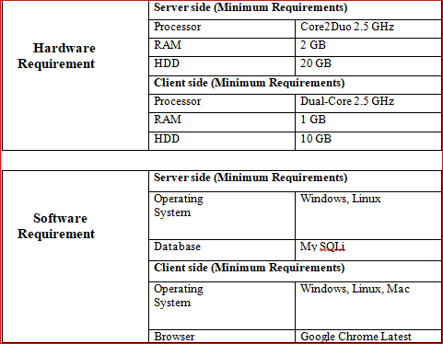
Hardware \ Software

Slide 10
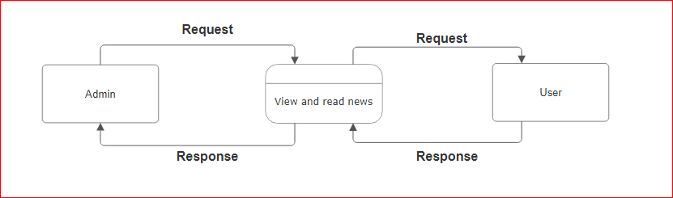
Data Flow Diagram
CONTEXT LEVEL DFD:

Slide 11
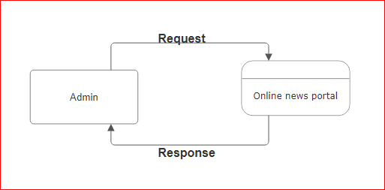
Data Flow Diagram
ADMIN 0 LEVEL DFD:

Slide 12
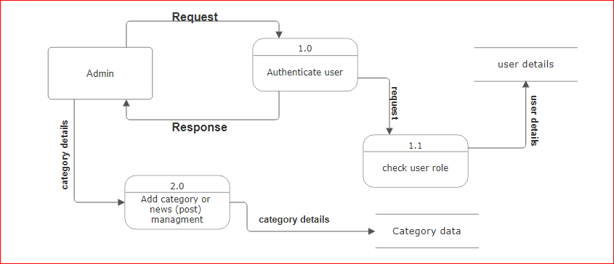
Data Flow Diagram
ADMIN 1ST LEVEL DFD :

Slide 13
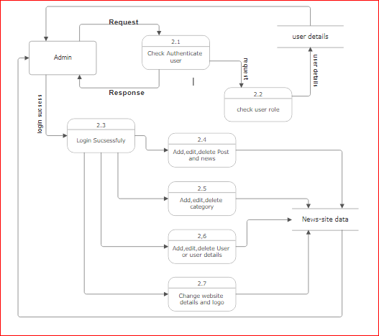
Data Flow Diagram
ADMIN 2ND LEVEL DFD :

Slide 14
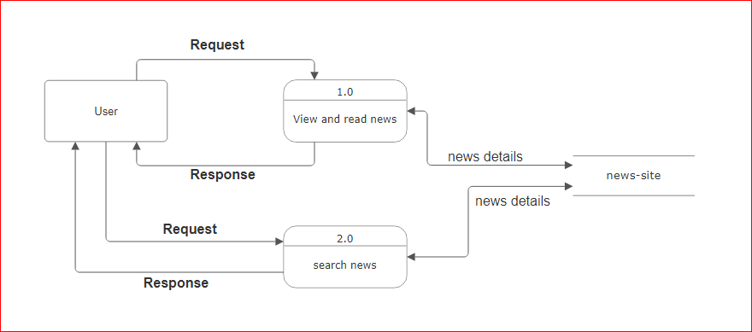
Data Flow Diagram
1st Level DFD for USER:

Slide 15
Database - Table
category table
Column Name | Data Type | Index | Description
category_Id | int(11) | Primary Key,AI | Category_ID
category_Name | varchar(100) | Not null | Category_Name
post | int(11) | Not null | POST

Slide 16
Database - Table :
post table
Column Name | Data Type | Index | Description
post_Id | int(11) | Primary,foreign Key,AI | Post ID
title | varchar(100) | Not null | Post Title
description | text | Not null | Post Description
category | varchar(100) | Not null | Post Category
post_Date | int(50) | Not null | Post Date
author | int(11) | Not null | Post Author
post_Img | Varchar(100) | Not null | Post Image

Slide 17
Database - Table :
settings table
Column Name | Data Type | Index | Description
id | int(11) | Primary Key,AI | Setting id
websitename | int(60) | Not null | Websitename
logo | varchar(50) | Not null | Website logo
footerdesc | varchar(255) | Not null | Website footer description

Slide 18
Database - Table :
user table
Column Name | Data Type | Index | Description
user_Id | int(10) | Primary Key,AI | User ID
first_name | varchar(30) | Not null | User first name
last_name | varchar(30) | Not null | User last name
username | varchar(30) | Not null | User name for login
password | varchar(40) | Not null | password
role | int(11) | Not null | ROLE user/admin

Slide 19
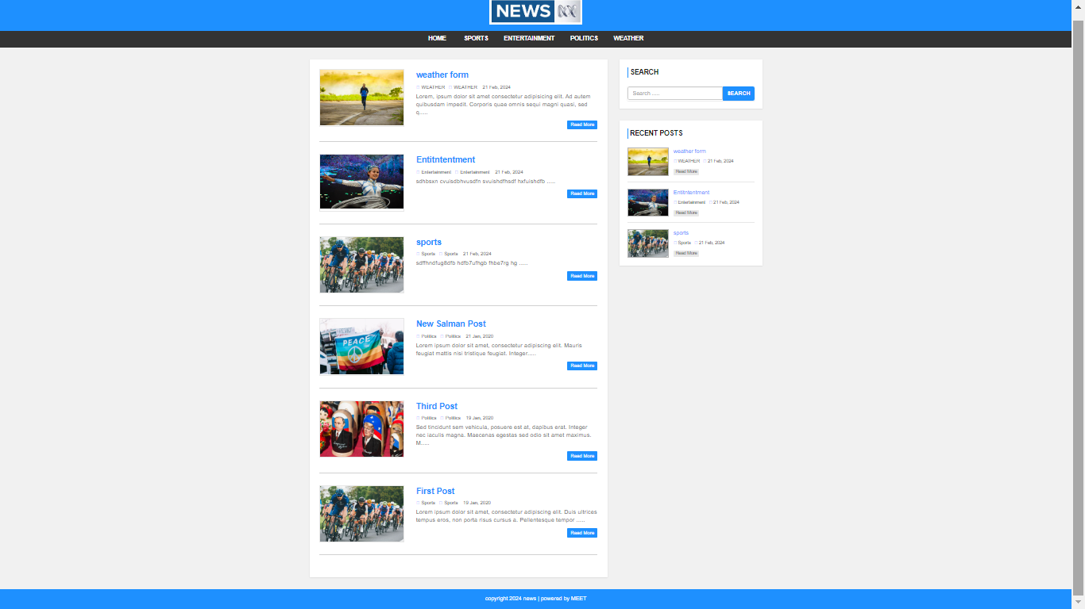
Function Graphics
HOME PAGE:
The Home Screen will consist of screen were one can browse through the news which we have on our website

Slide 20
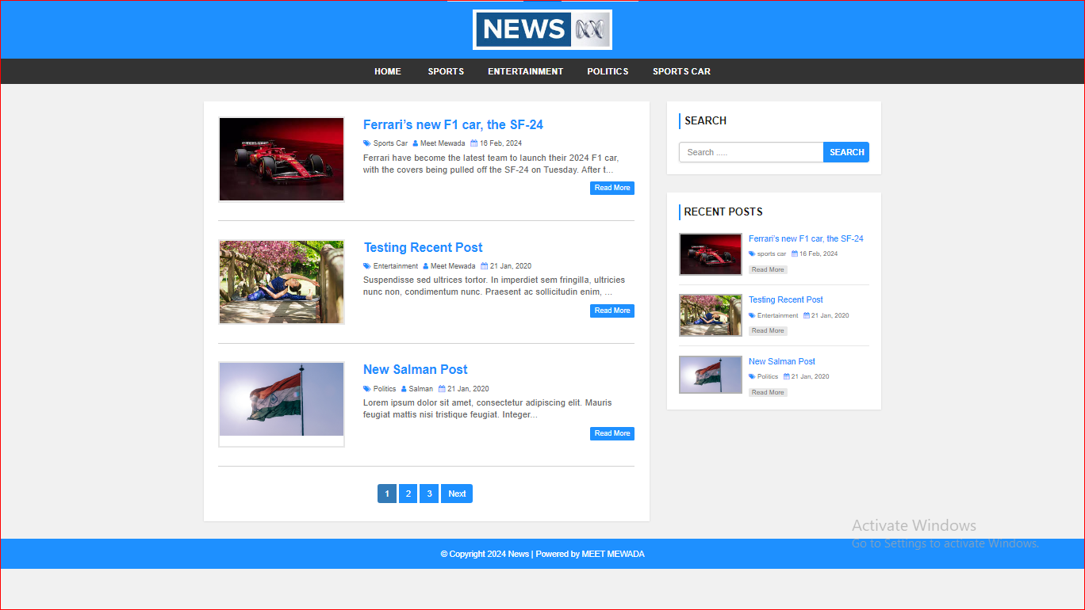
Function Graphics
This is all category in screen

Slide 21
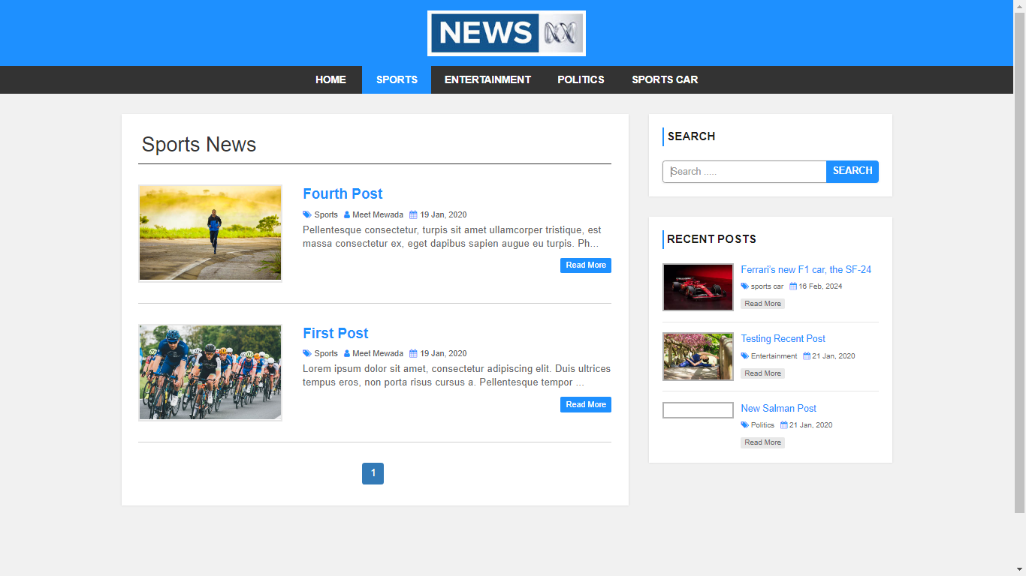
Function Graphics
All category Page :
This page consists of category details. This page appears same for both visitors and users.
Admin and Normal user can be add multiple category in Online News Portal
Category Page

Slide 22
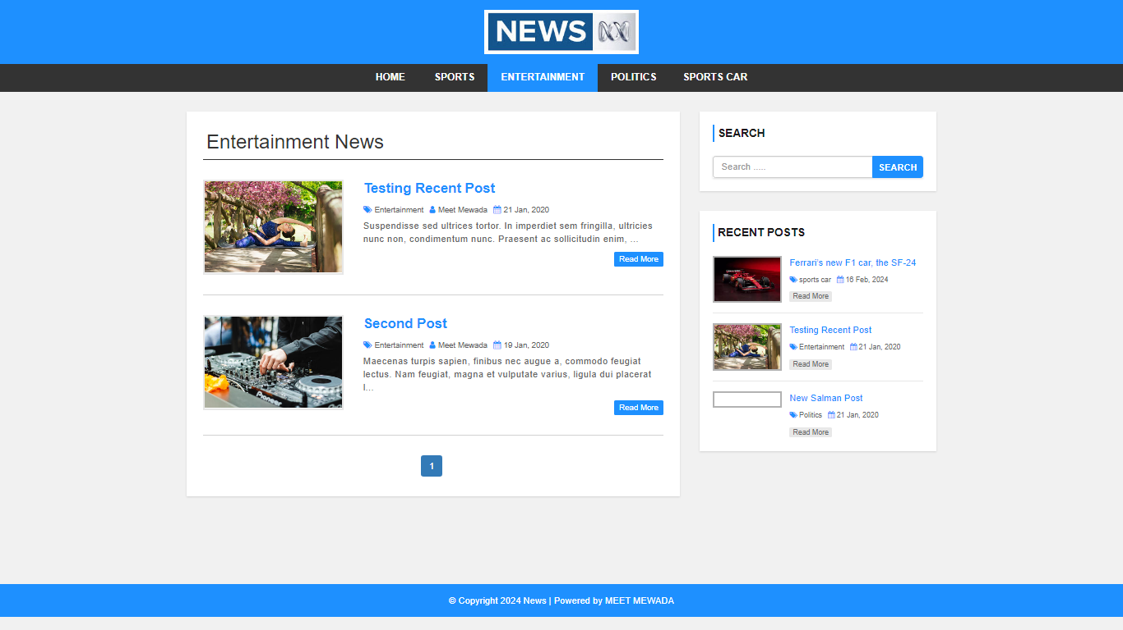
Function Graphics
Category(Entertainment)

Slide 23
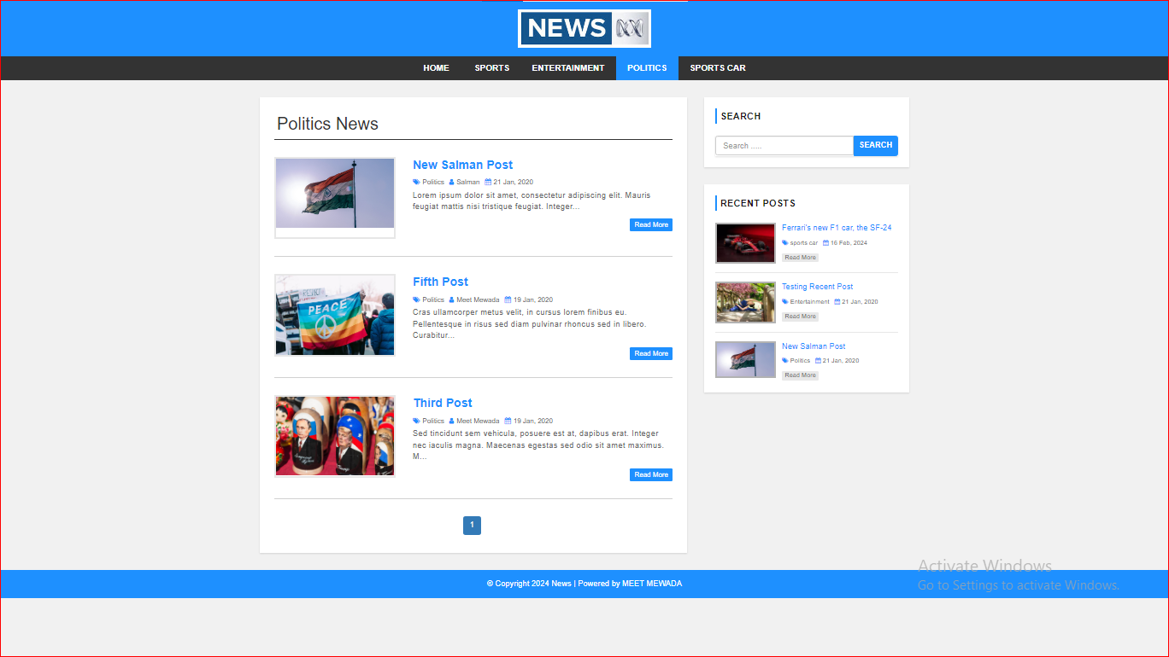
Function Graphics
Category (Politics)

Slide 24
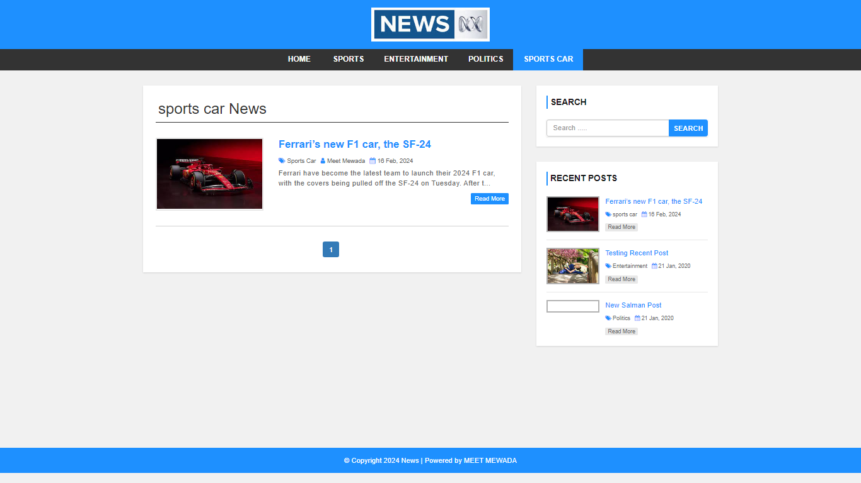
Function Graphics
Category(Sports car)

Slide 25
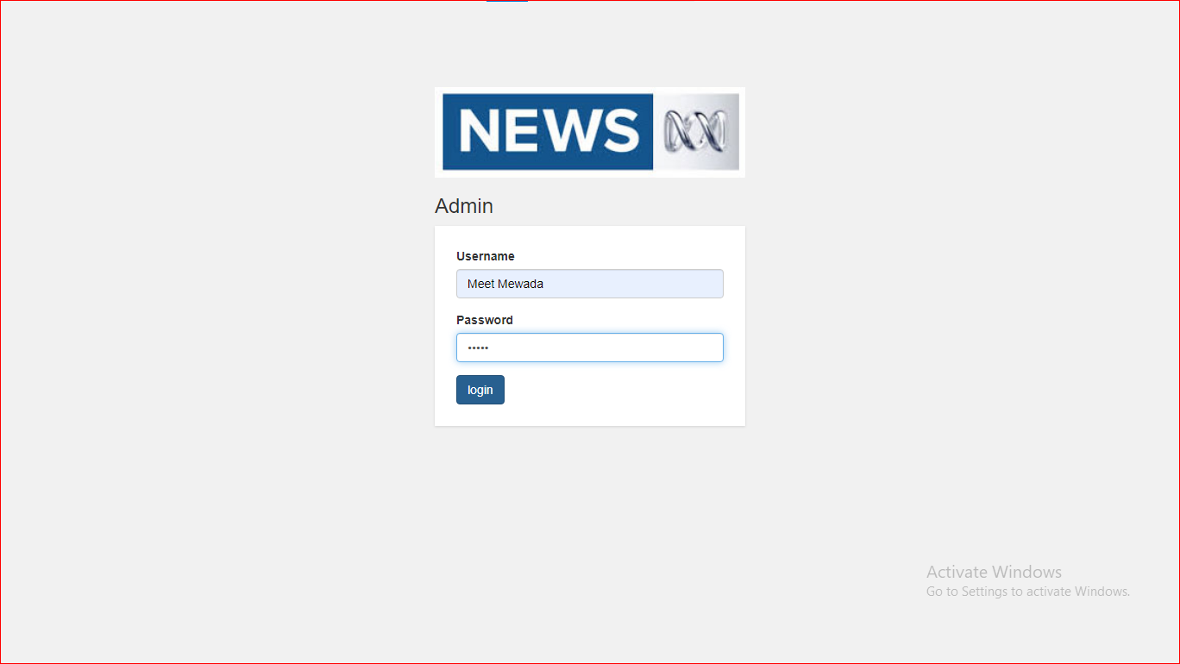
Function Graphics
ADMIN PAGE
Admin and Normal user can be Login hear

Slide 26
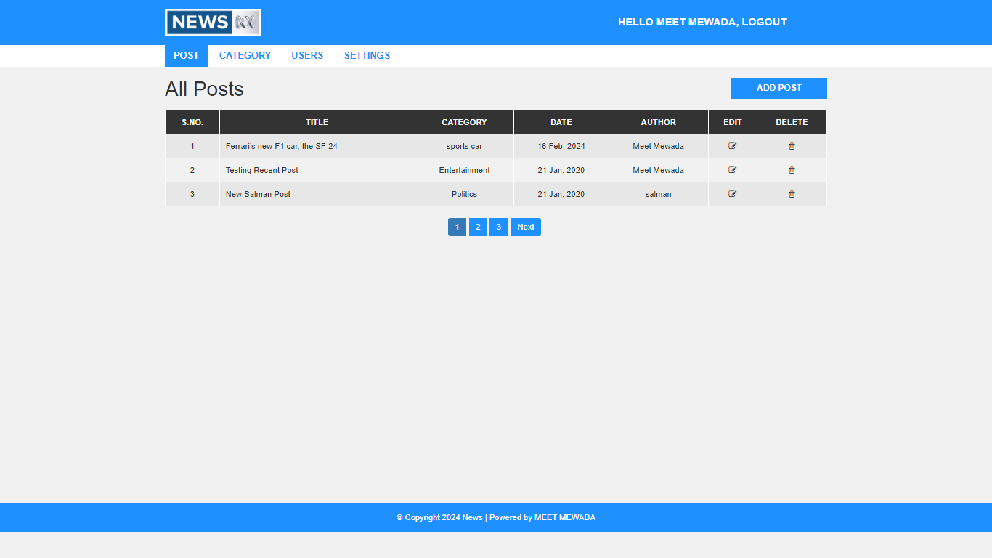
Function Graphics
Admin Post page
All post details and Edit and Delete a post and News Hear

Slide 27
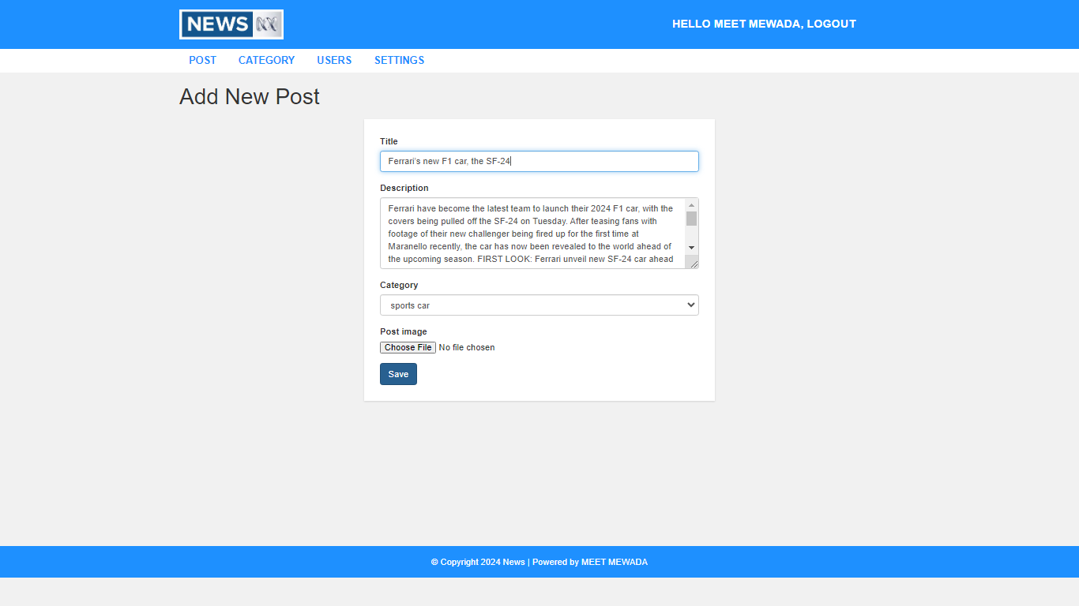
Function Graphics
Admin can be Add New Post Hear

Slide 28
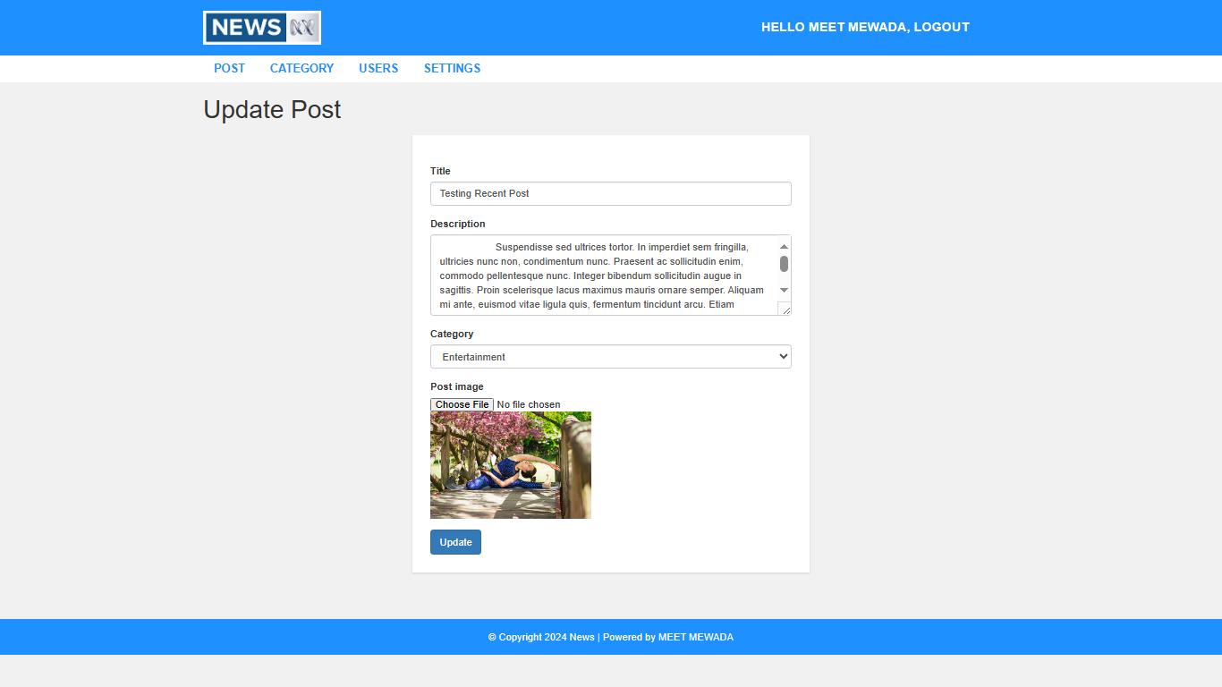
Function Graphics
Admin can be Update News and post

Slide 29
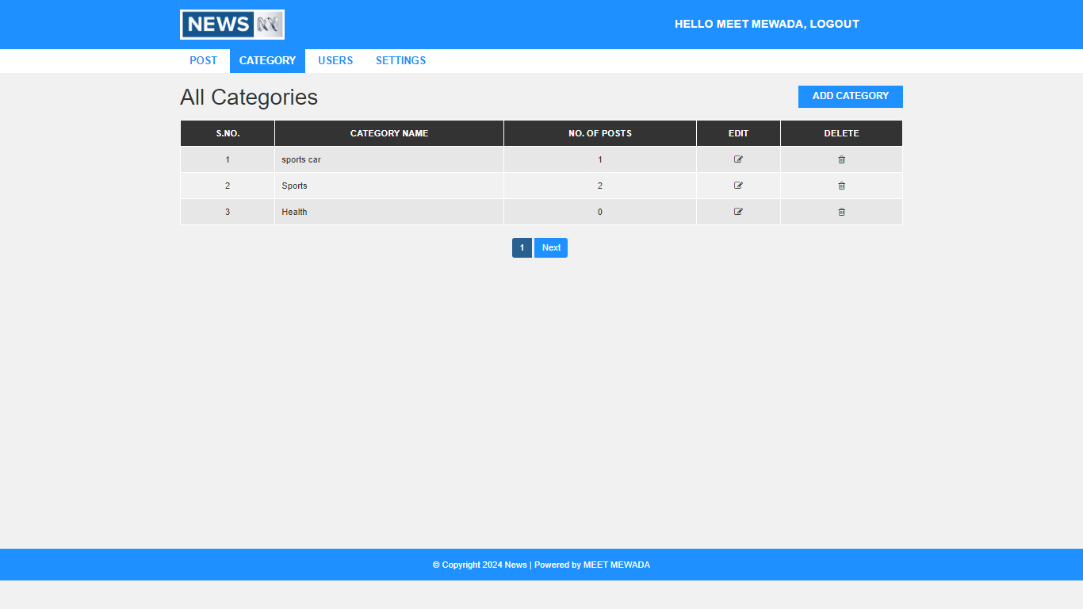
Function Graphics
Admin Category page
All Ctegory details hear and Admin add New category Edit and Delete a Category

Slide 30
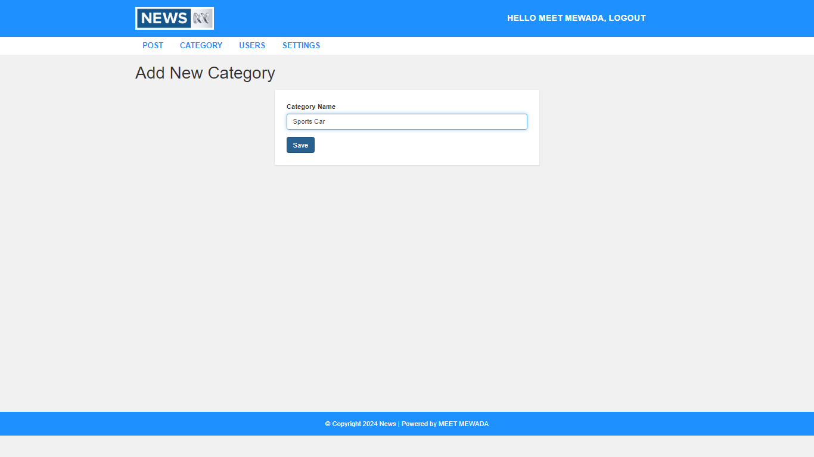
Function Graphics
Admin can be Add New Category

Slide 31
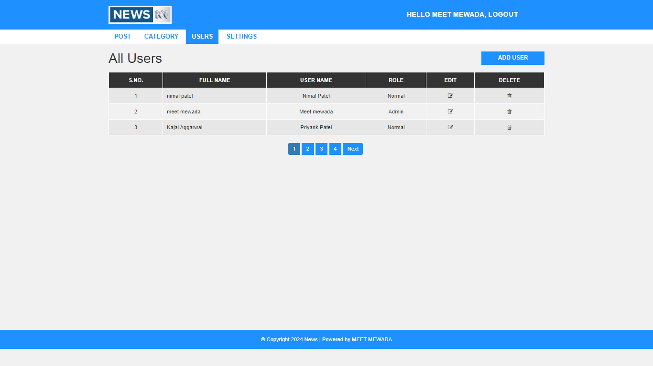
Function Graphics
Admin Users Page
All User details hear and Admin can be Edit and Delete a User

Slide 32
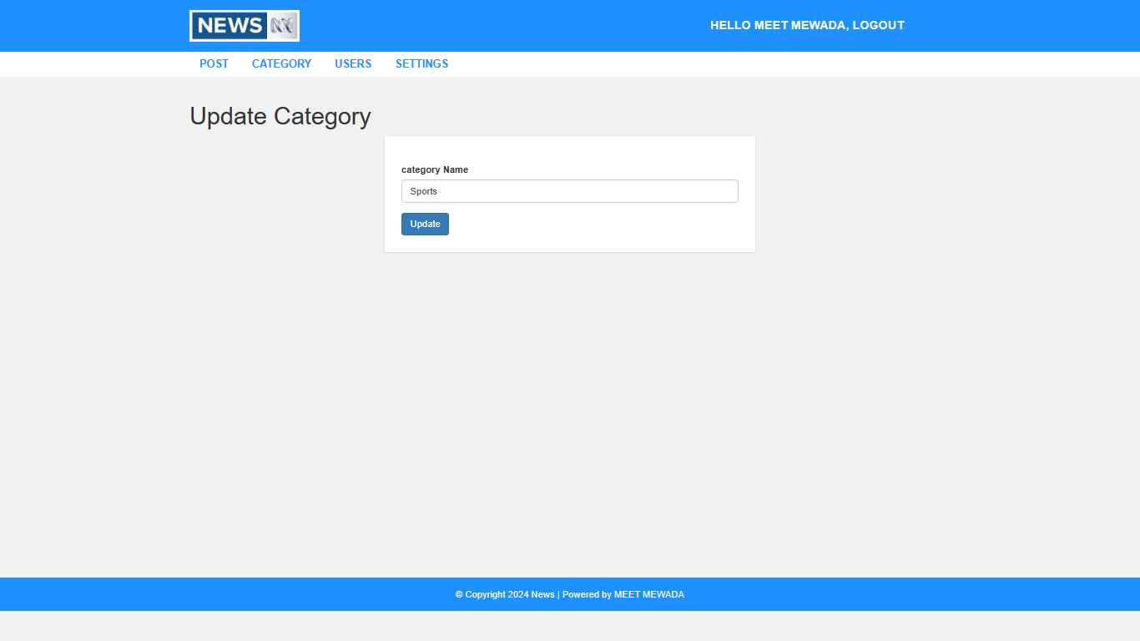
Function Graphics
Admin can be Update Category

Slide 33
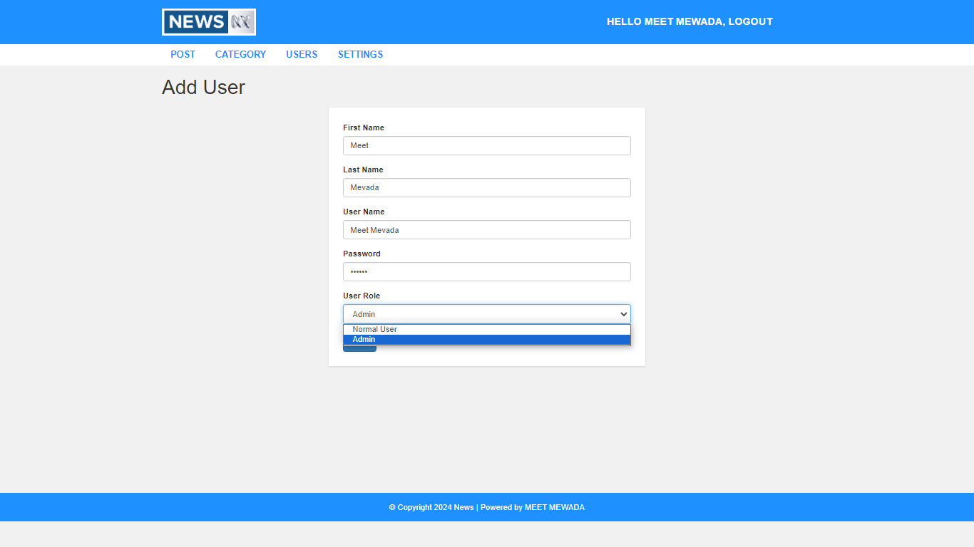
Function Graphics
Admin can be add new user like this new user add by its role like normal user and admin

Slide 34
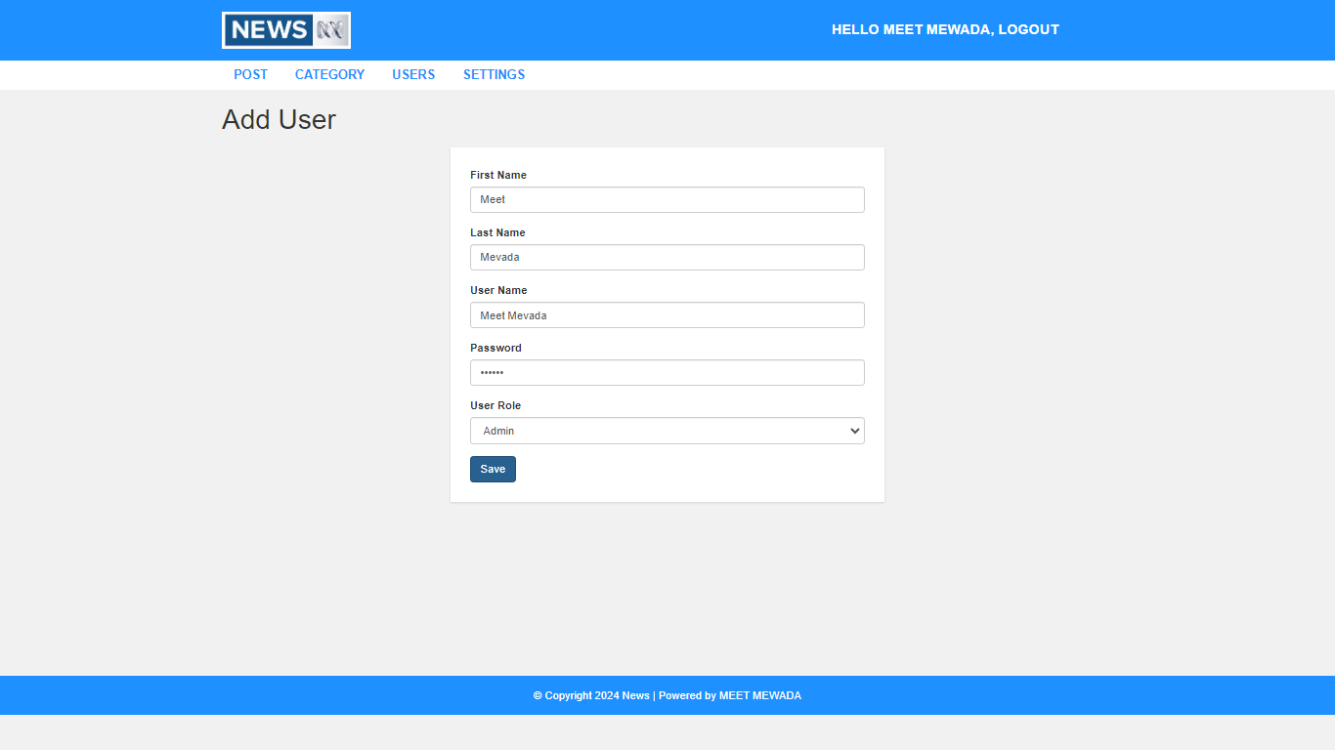
Function Graphics

Slide 35
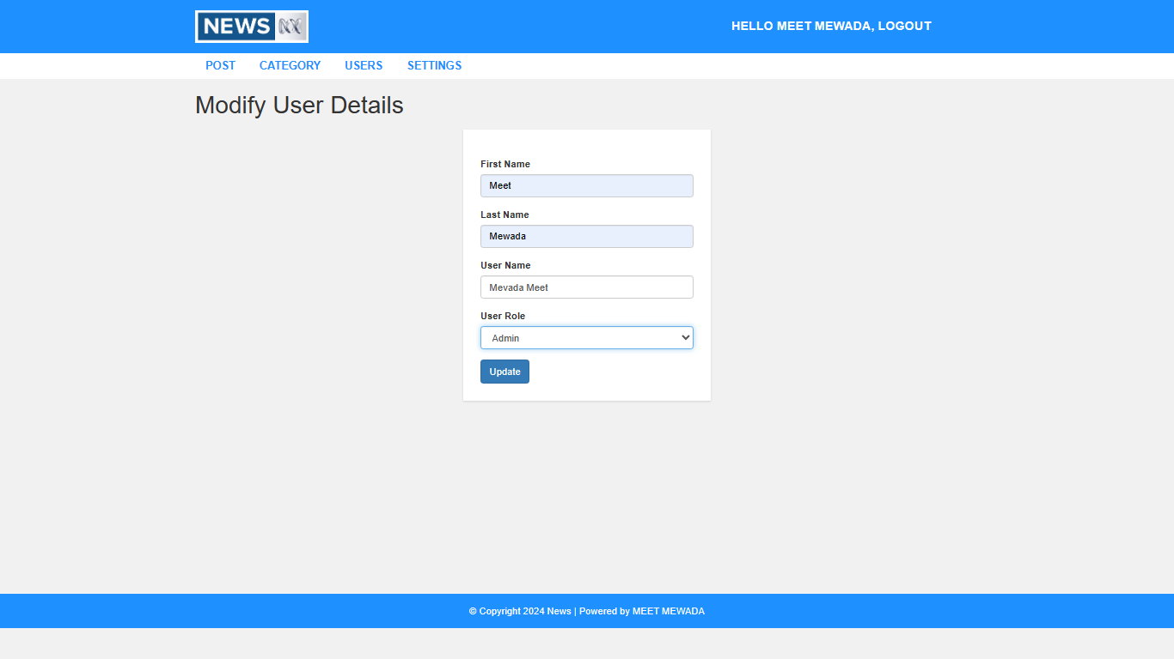
Function Graphics
Admin can be Update or modify user details

Slide 36
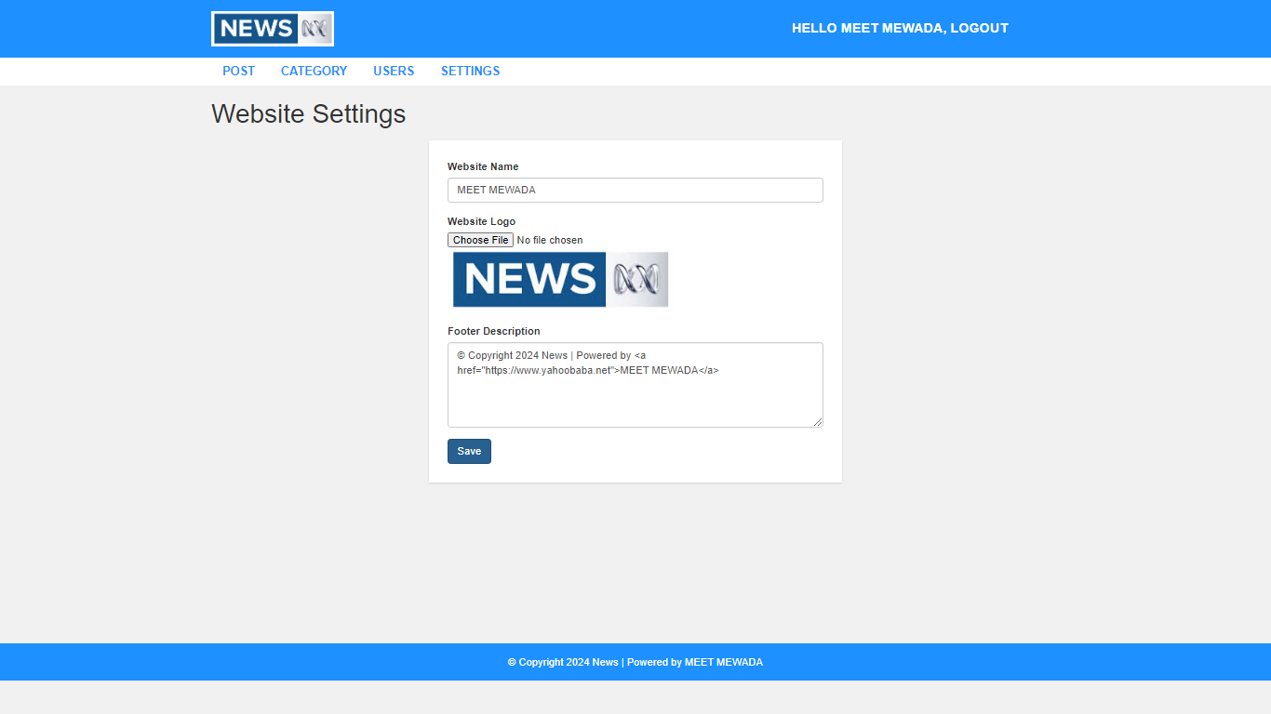
Function Graphics
Admin Website Settings Page
Admin can be change website name logo and footer details hear

Slide 37


